Slide 1
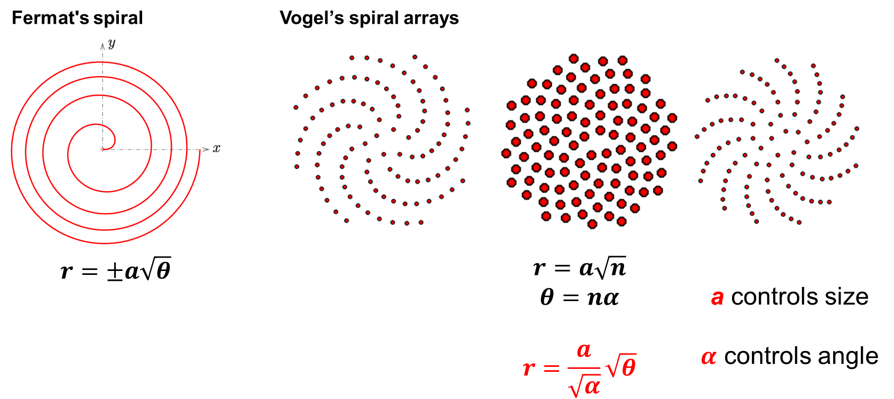
Fermat’s spiral

Slide 2
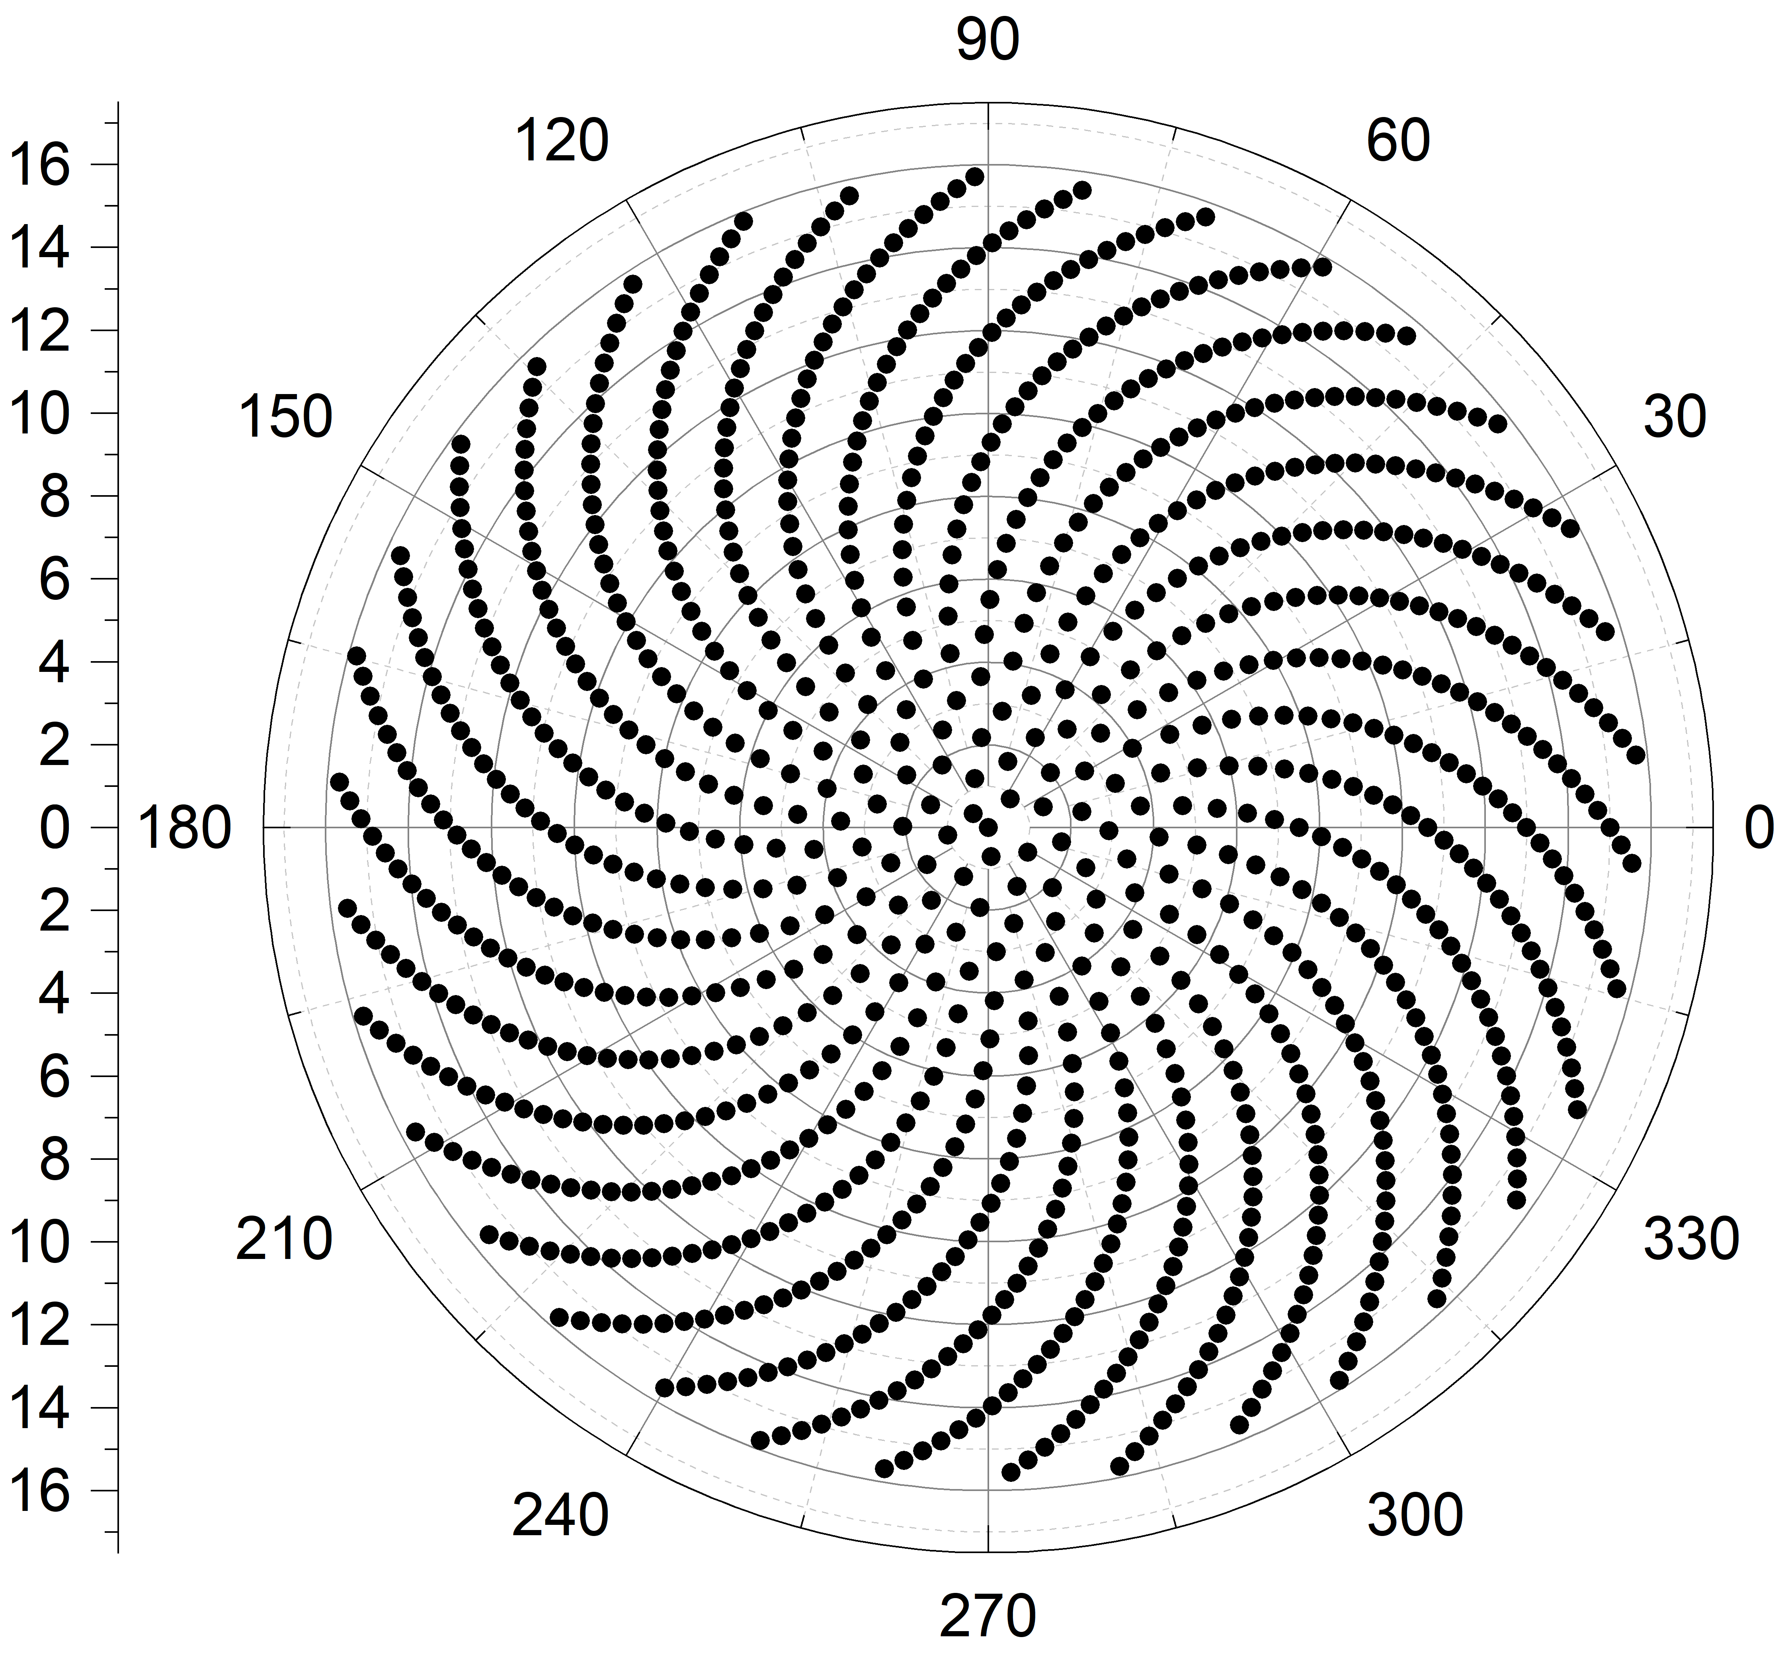
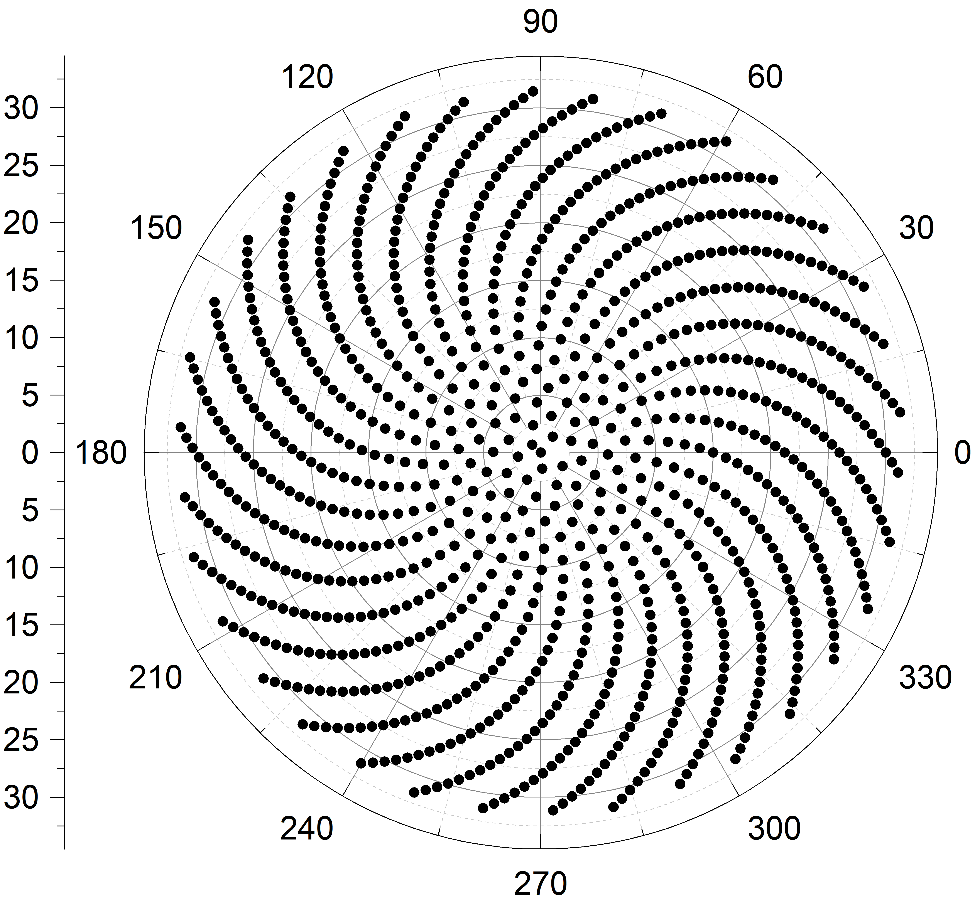

Scale factor, a
Changing a won’t change the shape, but the radius
a = 0.5
a = 1
a = 2
𝜶 = 137.6

Slide 3
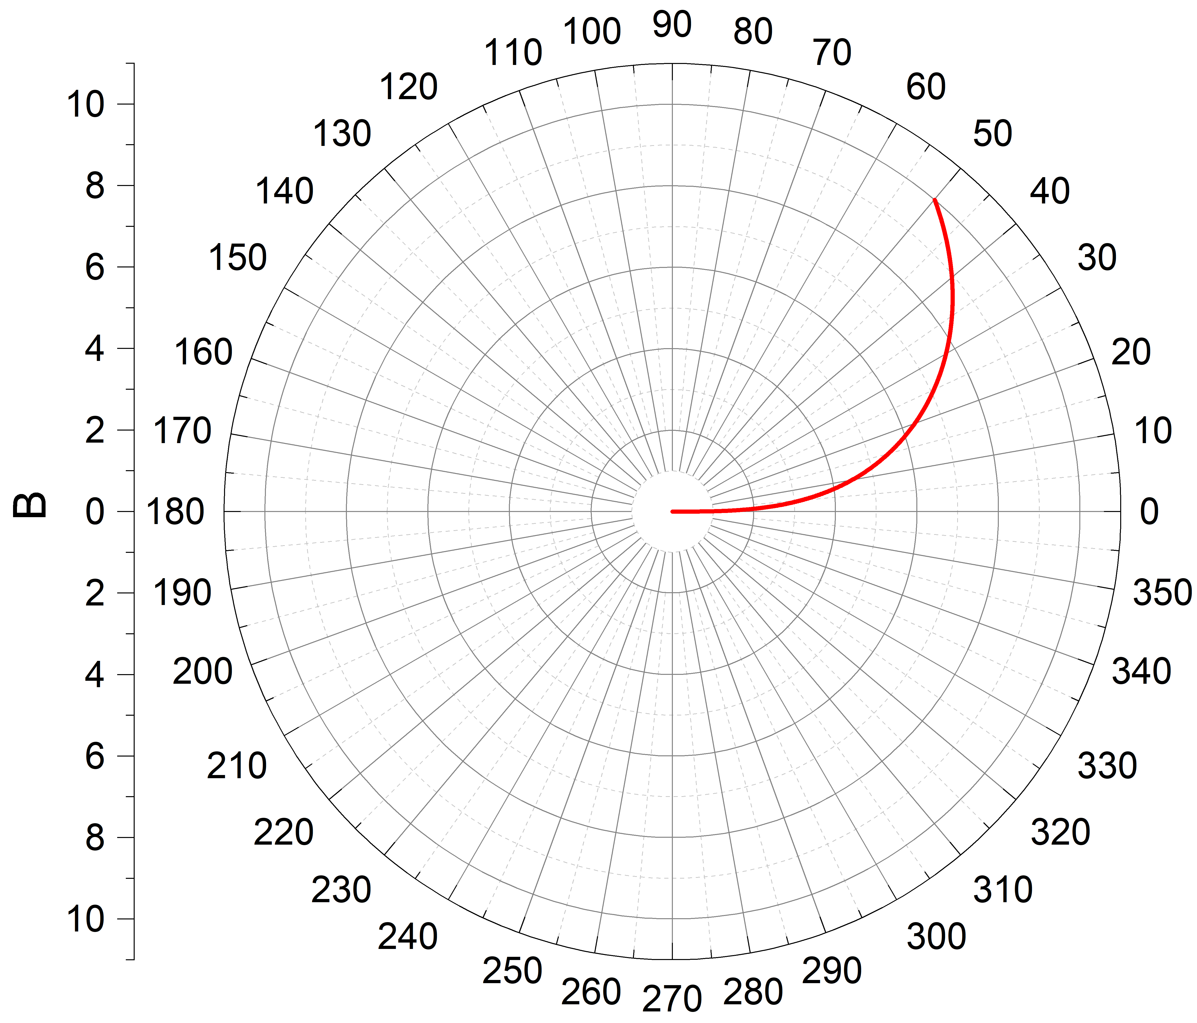
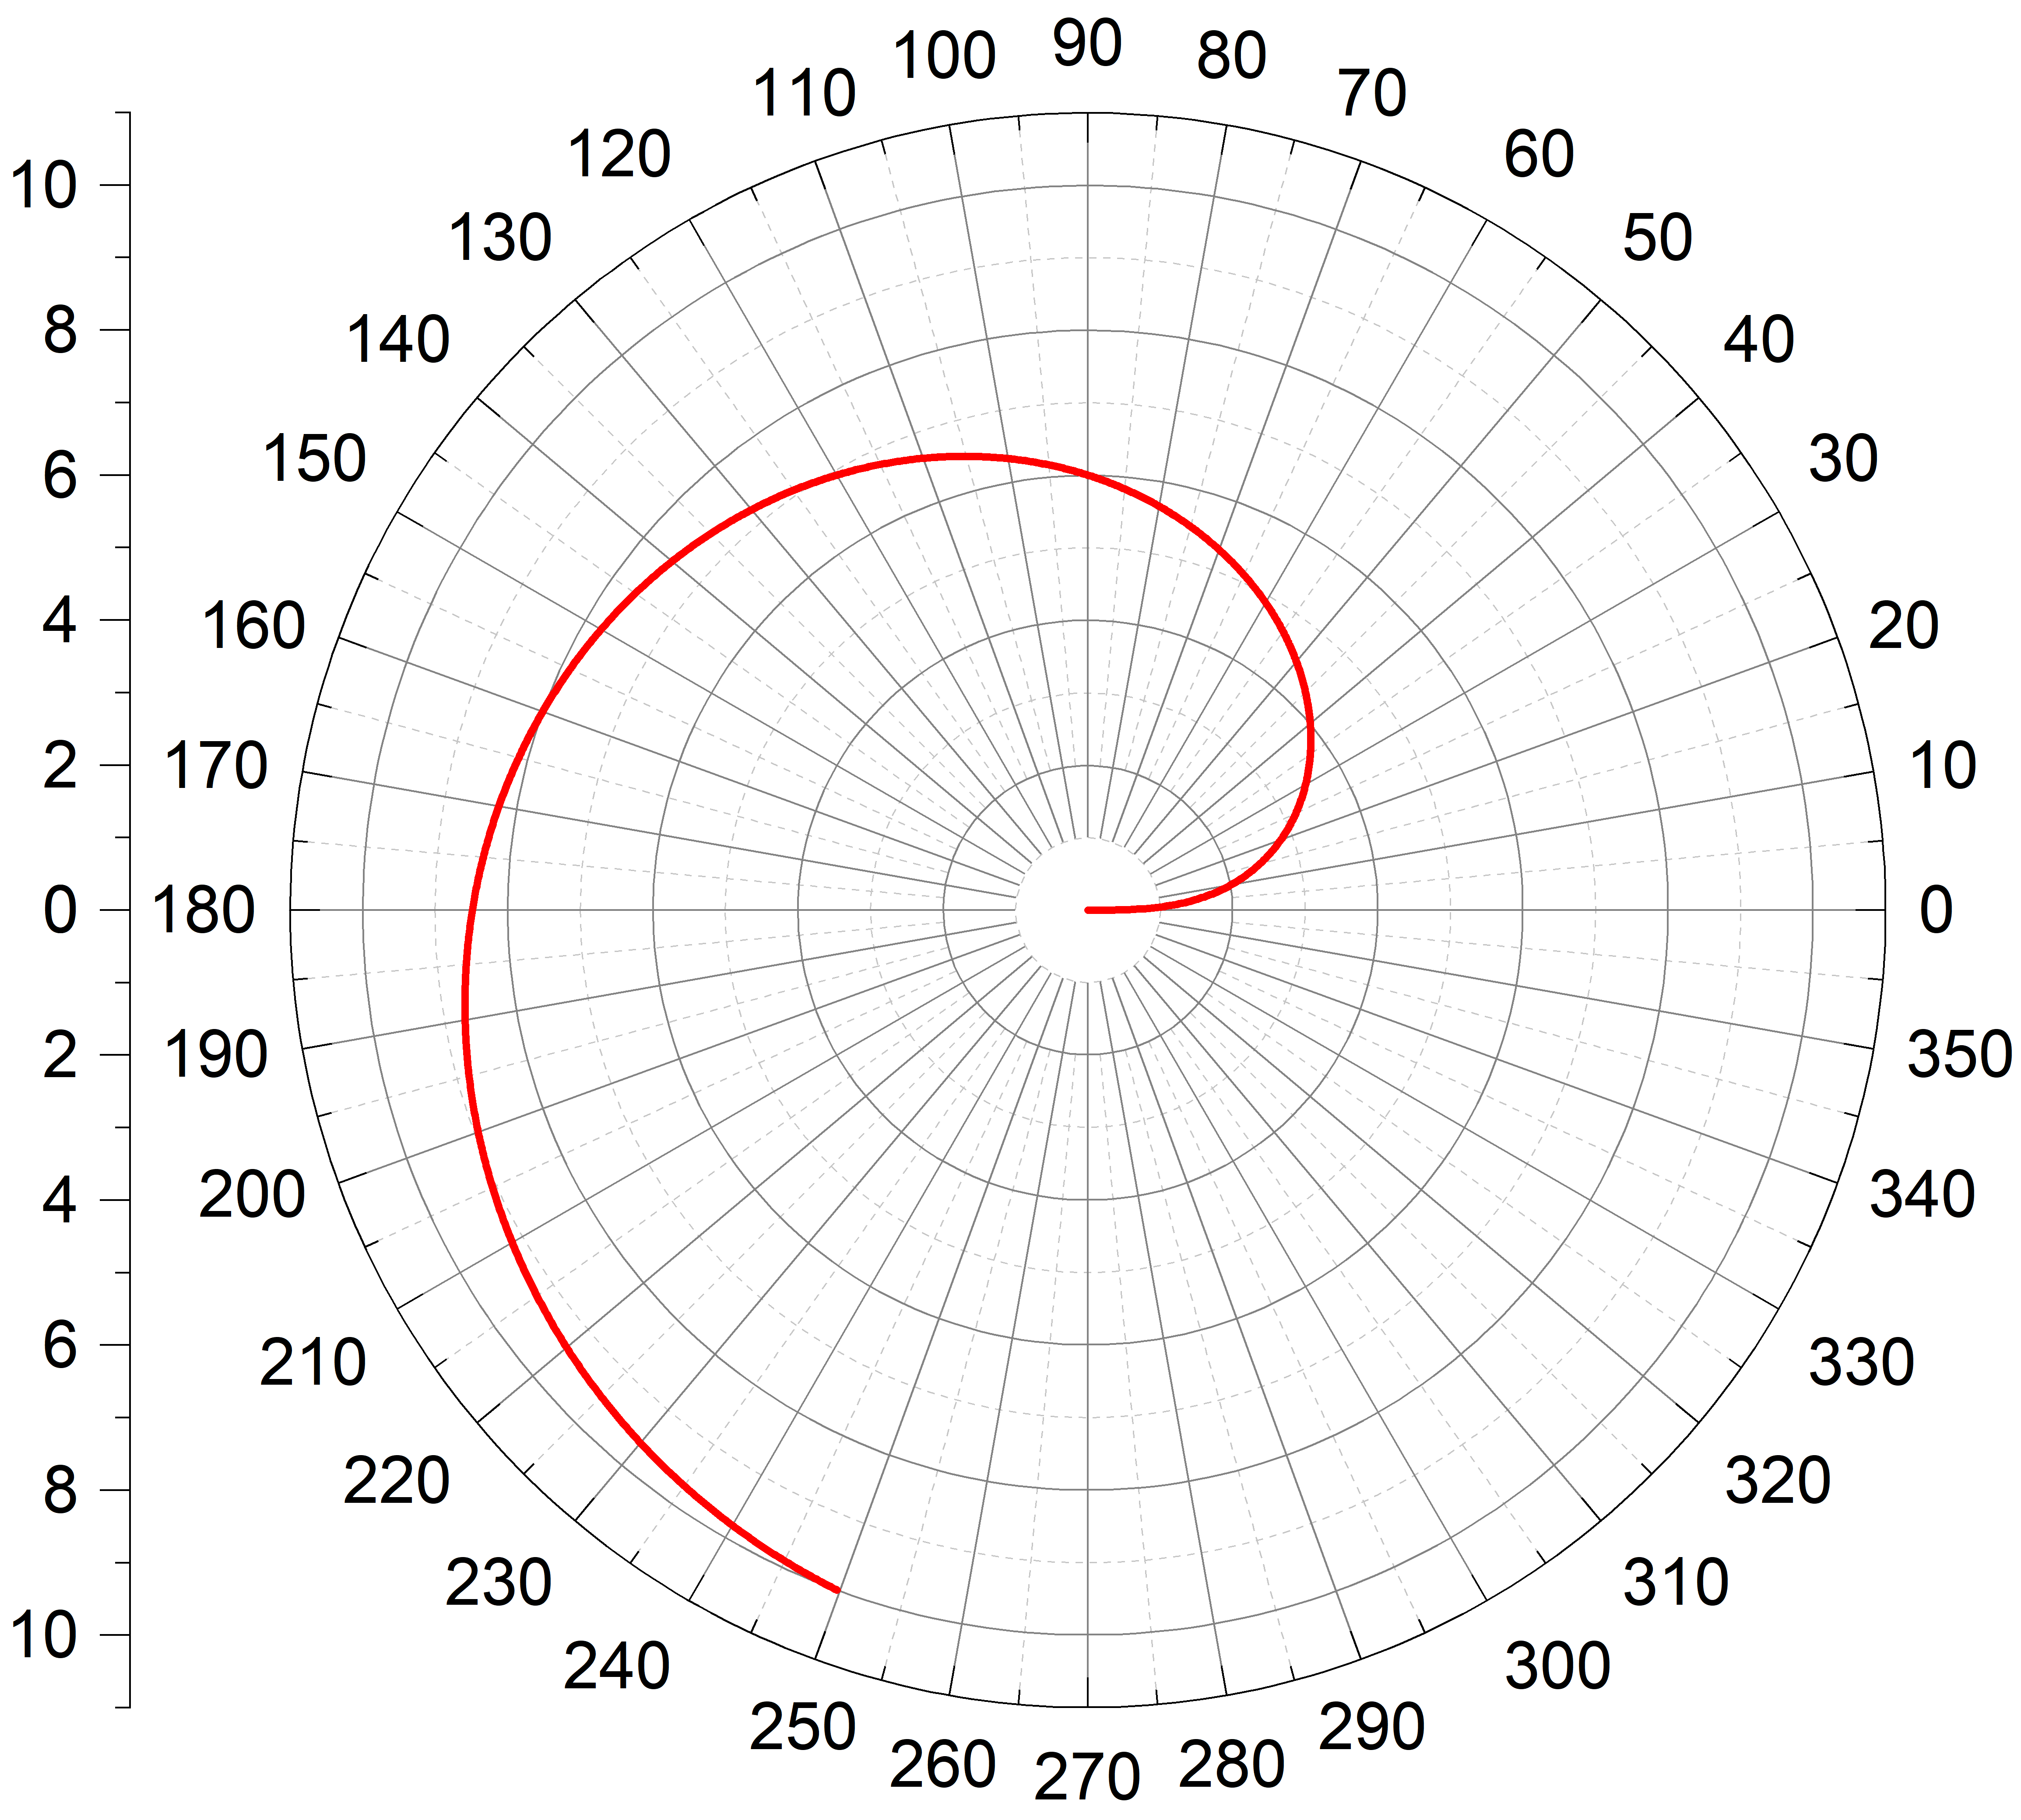
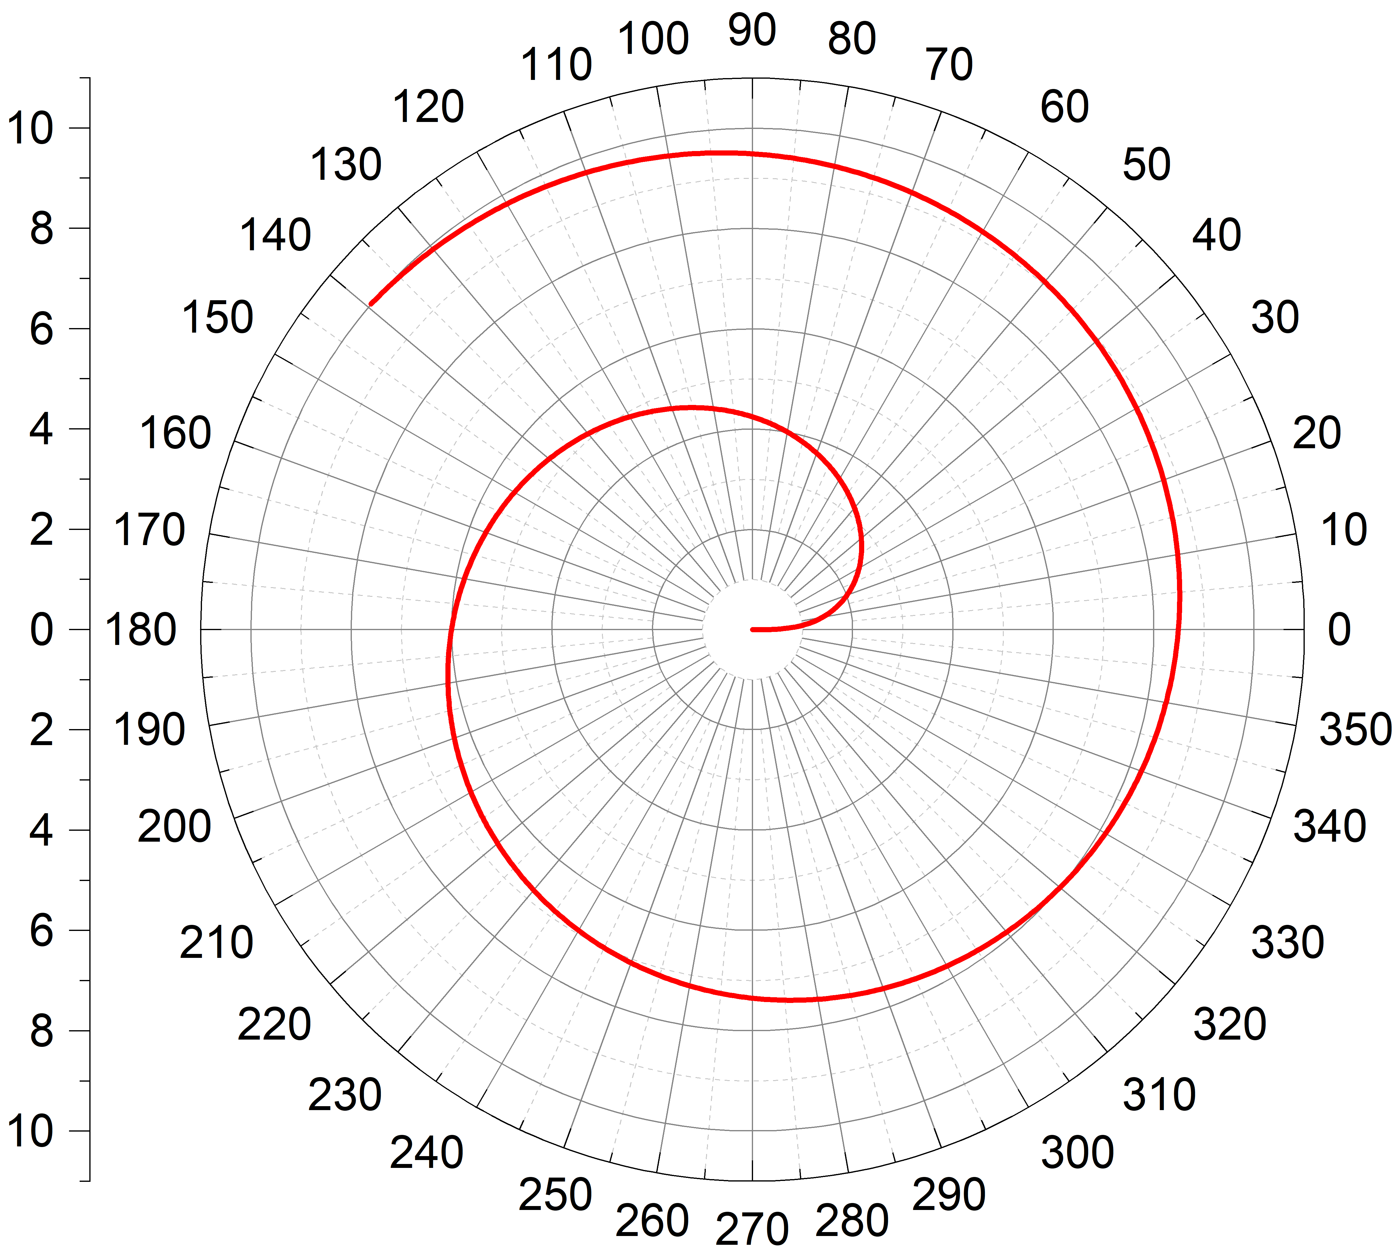
Angle factor, 𝜶
Changing 𝜶 won’t change the radius, but the shape (angle)
𝜶 = 0.5
𝜶 = 2.5
𝜶 = 5
By reducing the angle, it has similar spiral pattern to the nanostructures.
Target: Working on the simulation of the function for quantification of the angle.

Slide 4
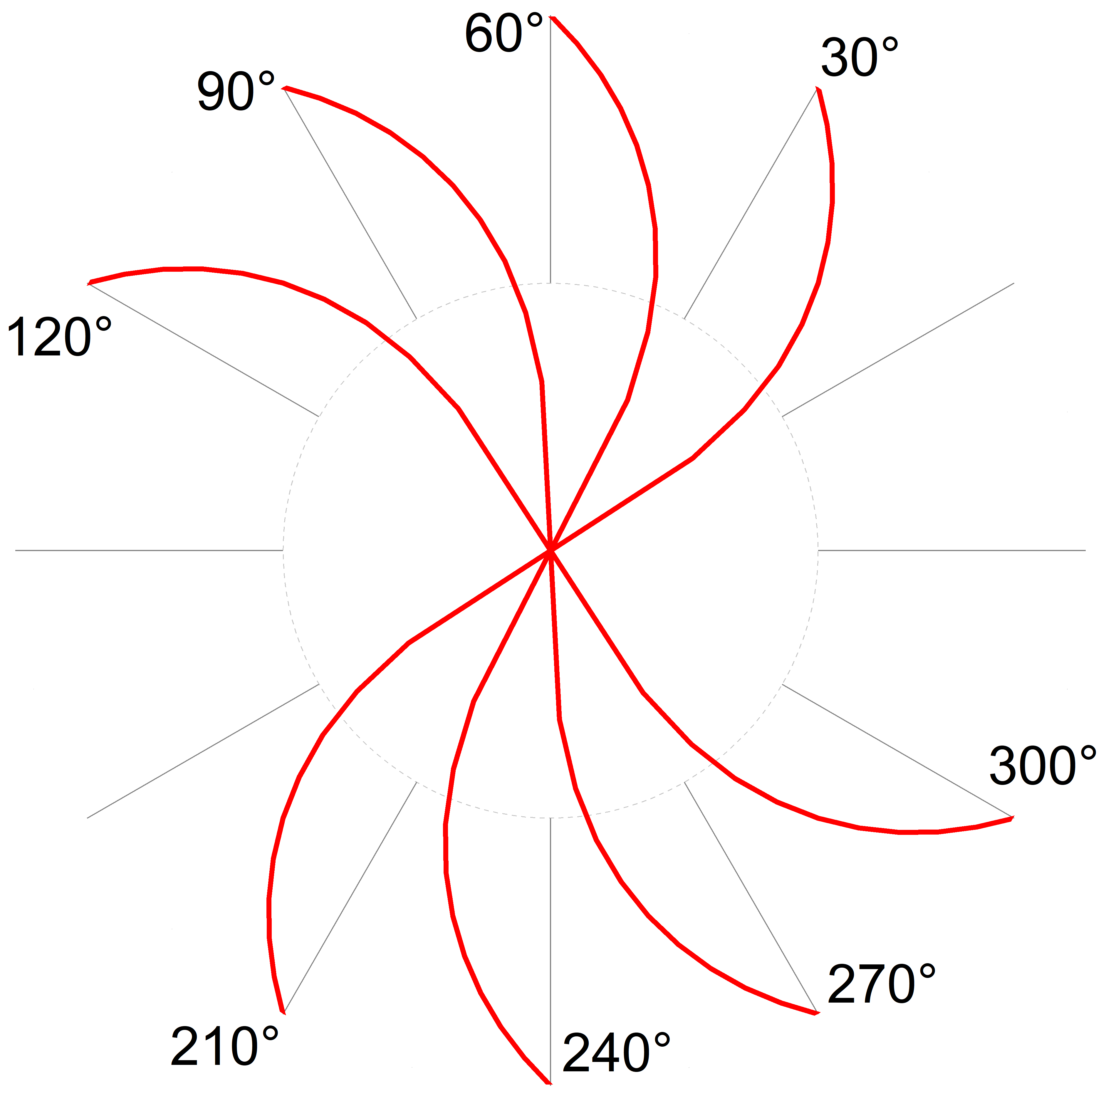
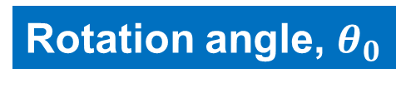
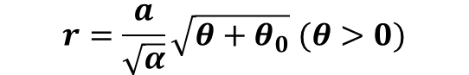
Rotation angle, $θ_{0}$
Changing $θ_{0}$ won’t change the radius and shape, but where the spiral pointing towards.
$$r=\frac{a}{\sqrt{α}}\sqrt{θ+θ_{0}} (θ>0)$$

Slide 5
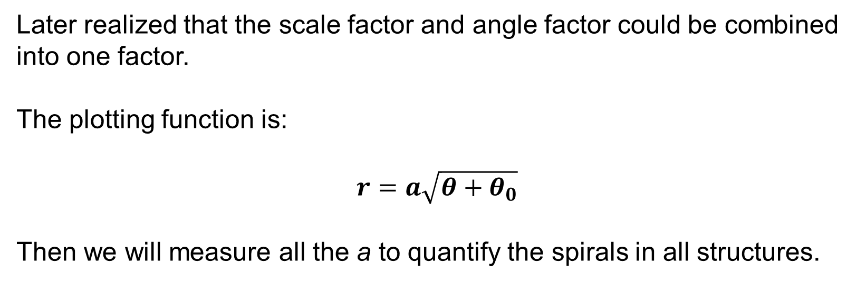
Function simplification
Later realized that the scale factor and angle factor could be combined into one factor.
The plotting function is:
$$r=a\sqrt{θ+θ_{0}}$$
Then we will measure all the a to quantify the spirals in all structures.

Slide 6
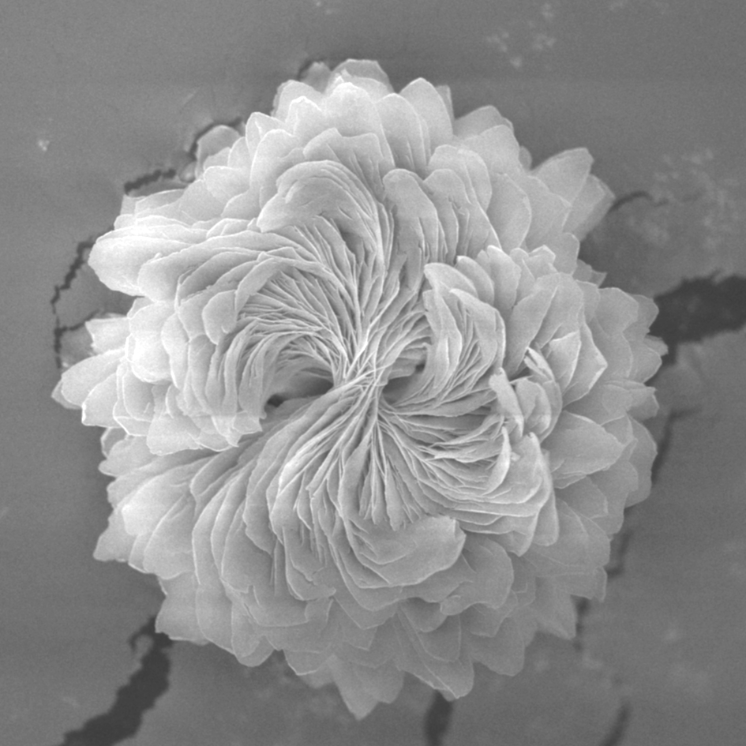
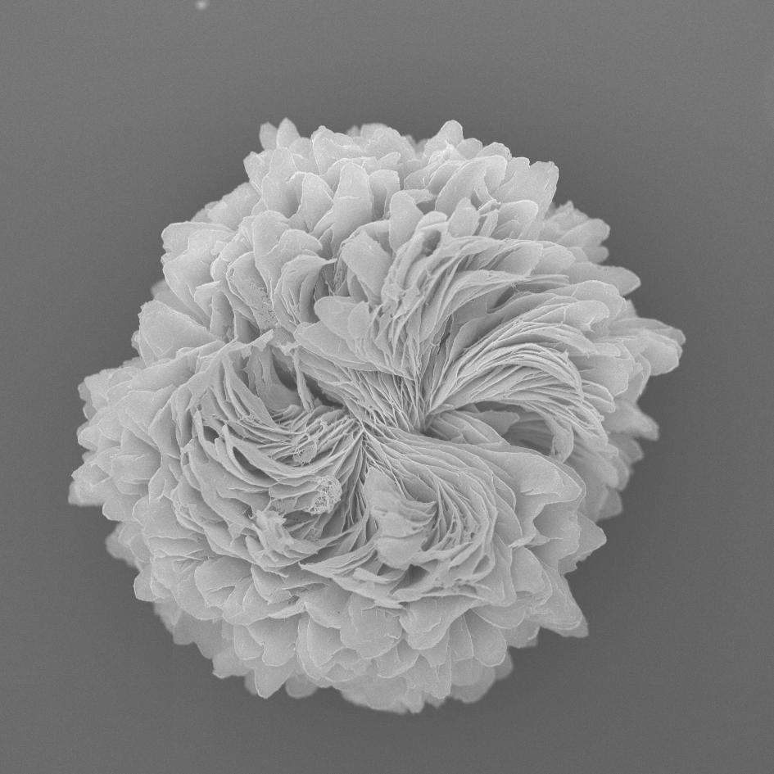
Target
Fit the spiral shape appeared on the synthesized particles.
3 um
3 um

Slide 7
Workflow
1. Resize particle image to a pre-set value
2. Read in particle image and numerate
3. Select starting point and track point
4. Spiral fitting with given formulars
5. Displace fitting results and Mean Square Error
6. Select best fit spiral result
7. Calculate the scaling factor based on the scale bar
8. Final result of a values and plotting

Slide 8
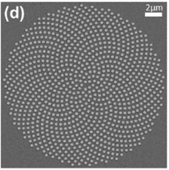
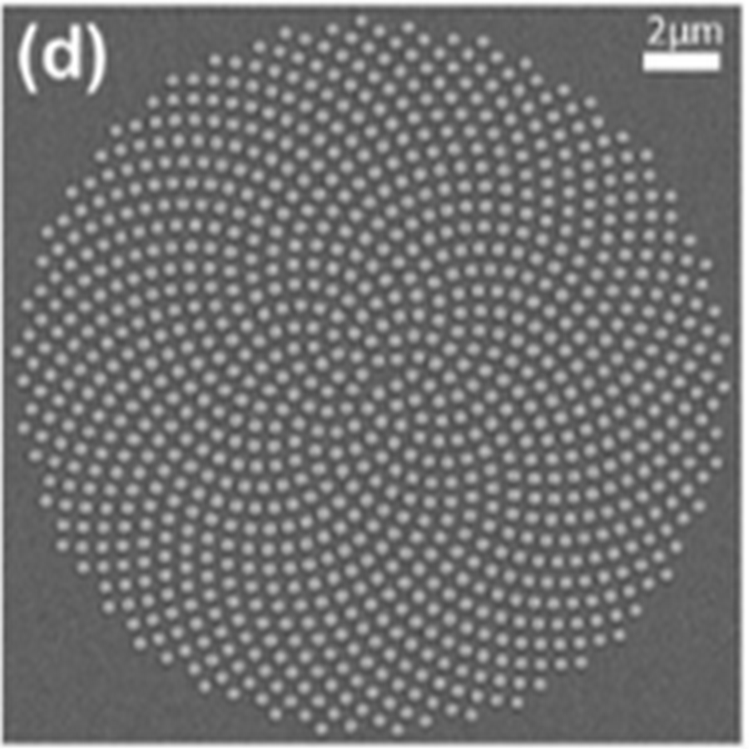
1. Resize
Target: Resize particle image to a pre-set value (e.g. 900*900 pixels)
As the MATLAB fitting function was based on the pixel coordination, resize the image to the same pixel size would simplify the fitting process.
Function used:
Manually resize images to 900*900 pixels with image viewing softwares.
Can also be achieved with: resize()
Lanczos3
189*189 pixels
900*900 pixels

Slide 9
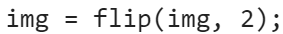
2. Read
Target: Read in the image and assign coordination to each of the pixels.
To identify the location where the user selected.
Function used:
isempty() & imread() – read the image and storage the coordinates.
Extra step:
The simulation function of spirals only fits with anticlockwise shape.
A mirroring option is added to simplify the coding.
Function used:
flip(img, 2) – mirror the image horizontally

Slide 10
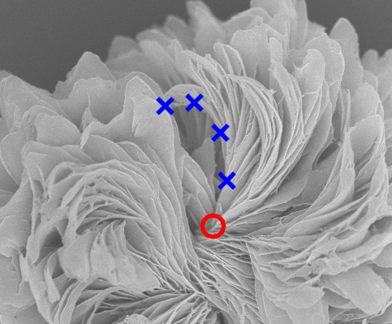
3. Point Selection
Target: Allow user to initialize the starting point of the spiral and pick the track.
Function used:
ginput() – read and storage the location selected on the image.
Selected Track point
Selected Starting point

Slide 11
4. Spiral fitting
Target: Fit the selected points to several given spiral formulas to find out the best fitting spiral shape.
Issue: MATLAB process the coordinates in the Cartesian coordinate system, while spiral formulas are generally in the Polar coordinate system. The fitting requires a conversion between the two coordination systems.
Function used:
[theta, r] = cart2pol(dx, dy);
dx = r*cosθ
dy = r*sinθ
y
r
θ
x

Slide 12
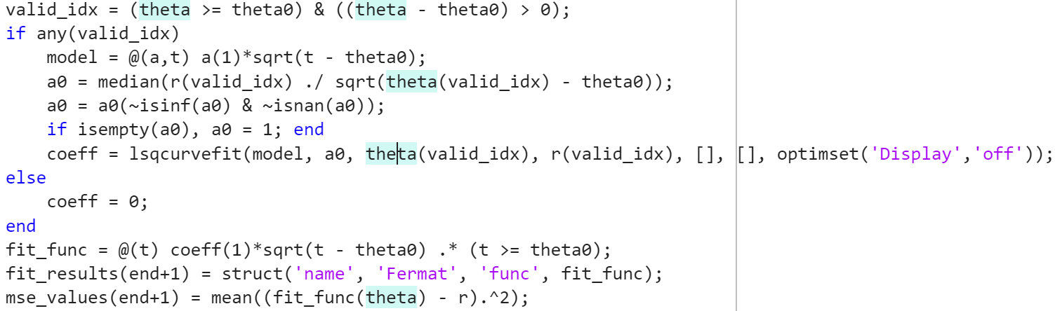
4. Spiral fitting
To assign the fitting functions.
Take the fitting of Fermat’s spiral as an example.
Decide whether input is valid
Define the fitting function
Calculate initial a values and take median number as a reference
Nonlinear least squares fitting
r
Construct the final fitting function
& Calculate fitting error.

Slide 13
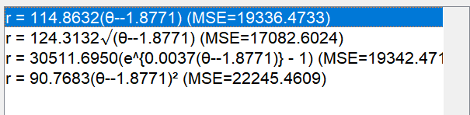
5. Fitting results and Mean Square Error
Target: After fitting, demonstrate the fitting results and allow user to choose the best fitting curve.
Function used:
fprintf() – list the fitting results
For example:
Smaller MSE value gives better fitting.

Slide 14
6. Select best fit spiral result
Target: Select and save the best fit curve.
No external description needed.
For example:
Smaller MSE value gives better fitting.

Slide 15
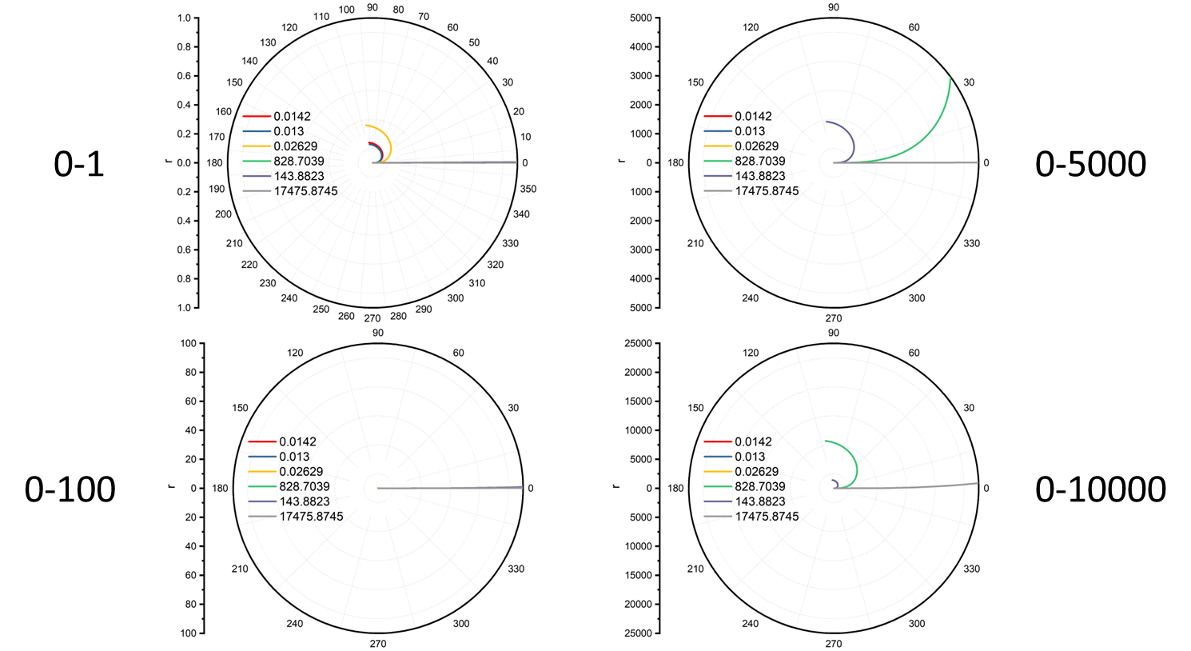
7. Scaling factor
As the fitted spiral shape is not only affected by the shape, but also by the size of the shape.
Take Fermat’s spiral as an example.
Larger a gives a large spiral shape.

Slide 16
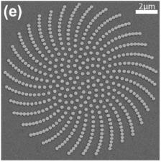
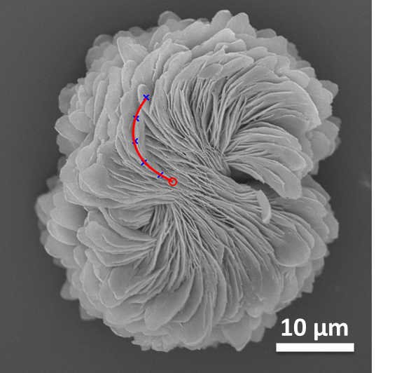
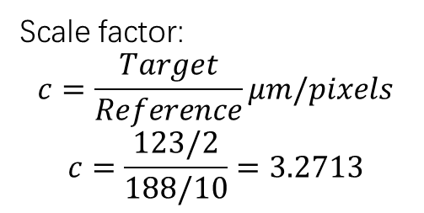
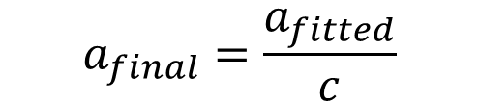
7. Scaling factor
As the fitted spiral shape is not only affected by the shape, but also by the size of the shape.
Calculate the size ratio between the particle sizes and reference particle size (our HCPs)
Scale factor:
$$c=\frac{Target}{Reference}μm/pixels$$
$$c=\frac{123/2}{188/10}=3.2713$$
In the same scale
$$a_{final}=\frac{a_{fitted}}{c}$$
2um – 123 pixels
10um – 188 pixels
𝑎_𝑓𝑖𝑡𝑡𝑒𝑑 = 85.3368
𝑎_𝑓𝑖𝑛𝑎𝑙= 26.0865
Notes:
Check fitting function with the literature values.
Plot multiple spirals on the same batch, plot the fitted function on top of the figure together with the fitted curve.(For both + - cases) / For reversed handedness as well.
Summarize the fitted values for both chirality, showing the static spiral shape at optimal synthesis at both
Plot the difference of Fermat’s spiral and Archimedean spirals at the same scale and tan theta.
H-H 2D NMR for bowtie and spiral particles.
Contact Pritish for TEM grid preparation on spiral synthesis.
Gold nanoparticles – 5, 20 nm_25 mL

Slide 17
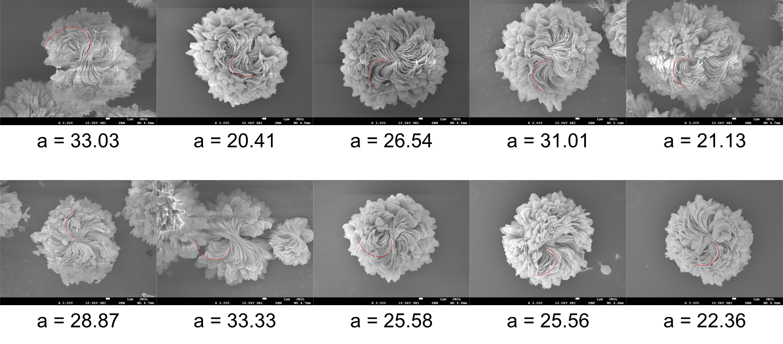
Fitting on particles
Problem: Scale is not standardized.

Slide 18
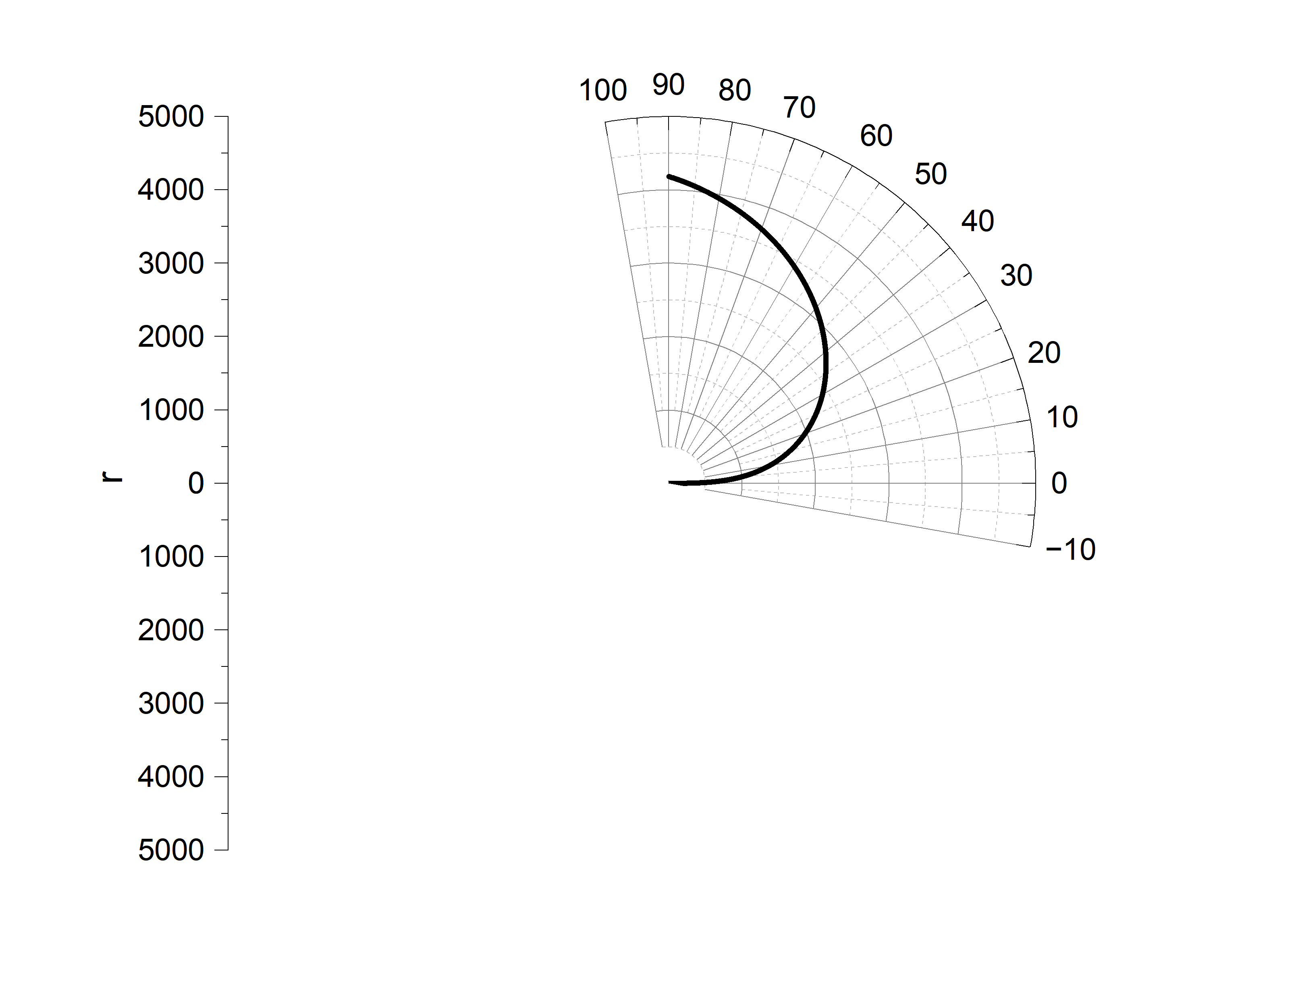
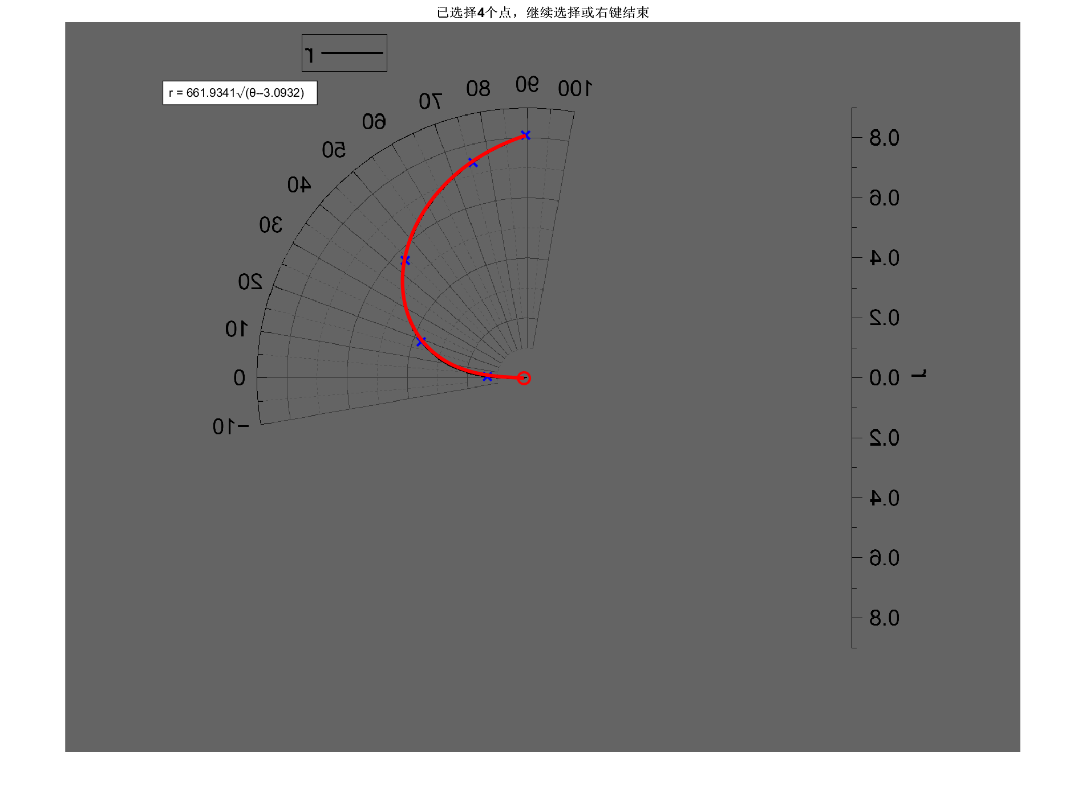
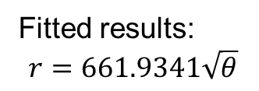
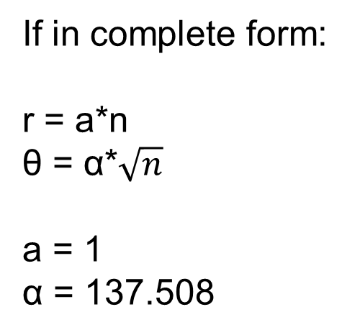
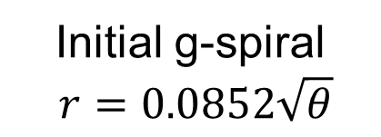
Scaling Issue
Initial g-spiral
$$r=0.0852\sqrt{θ}$$
If in complete form:
r = a*n
θ = α*$\sqrt{n}$
a = 1
α = 137.508
Fitted results:
$$r=661.9341\sqrt{θ}$$

Slide 19
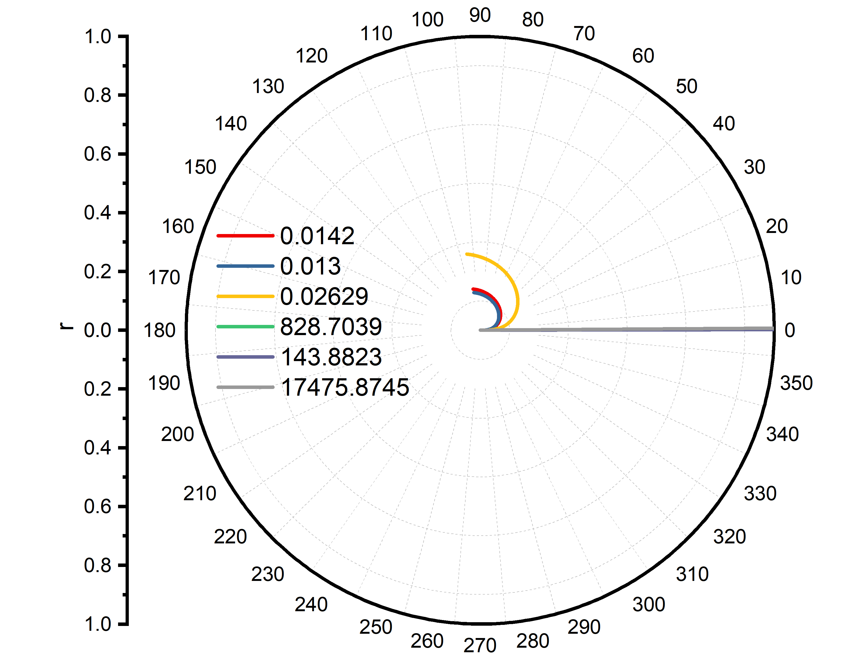
Spiral scaling
About the scaling in the plot
After plotting part of the spirals to see how the scale is affecting…

Slide 20
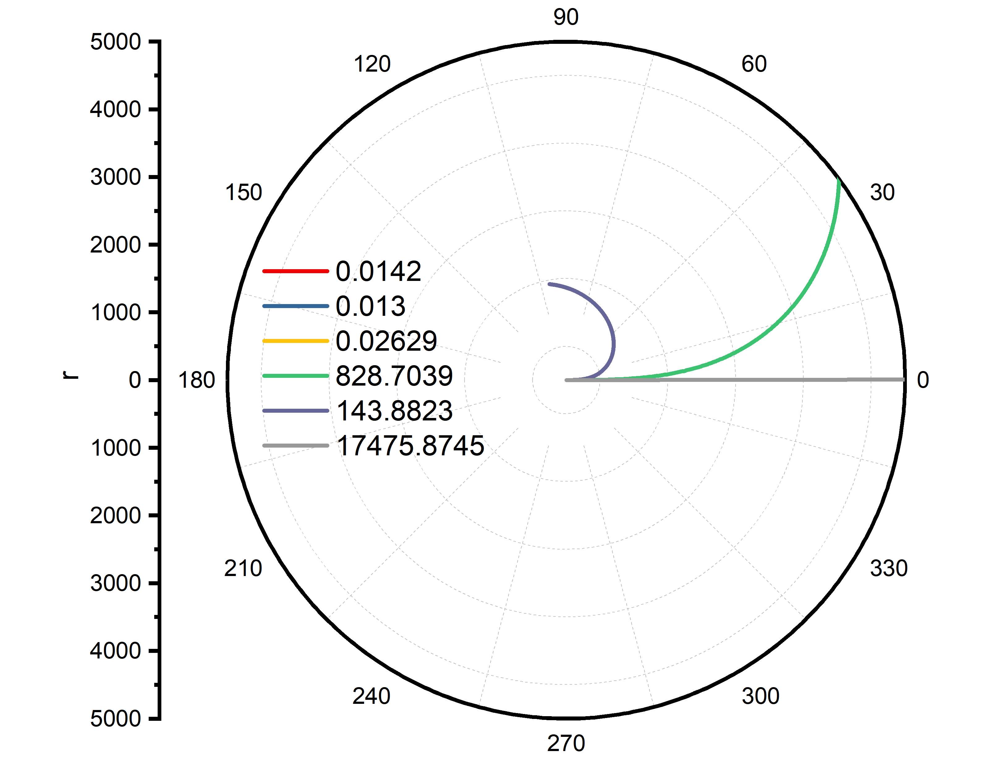
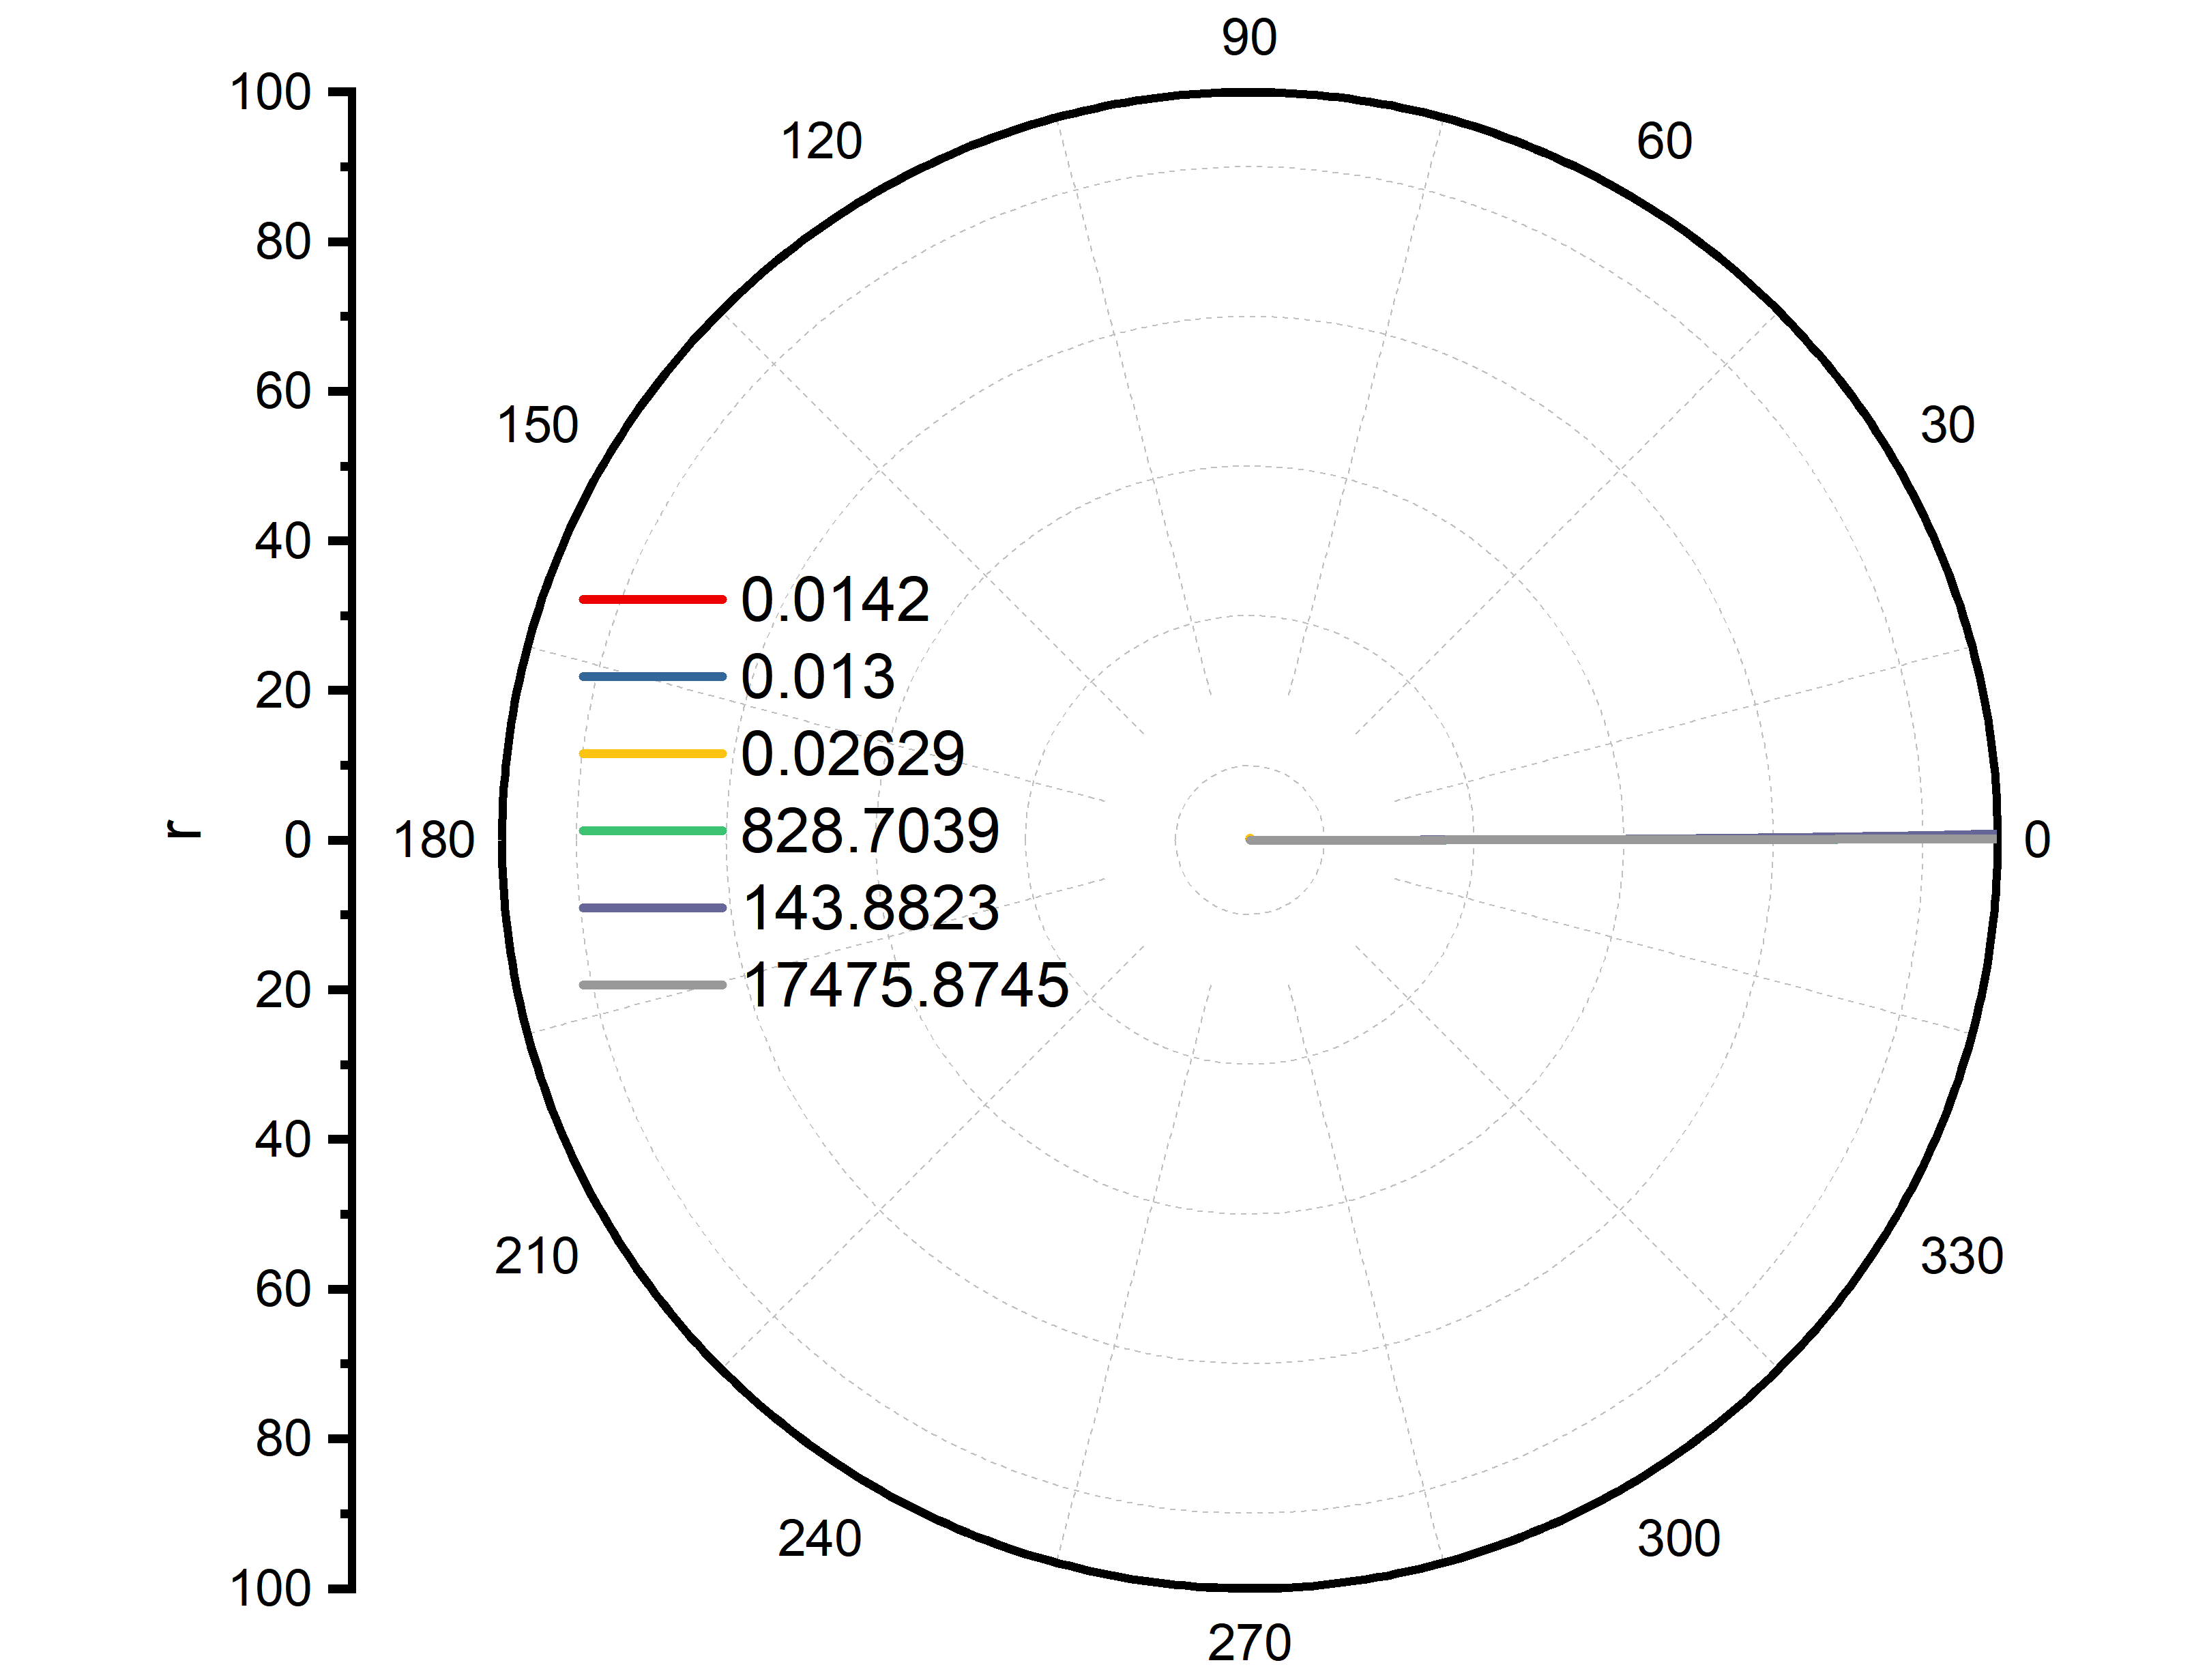
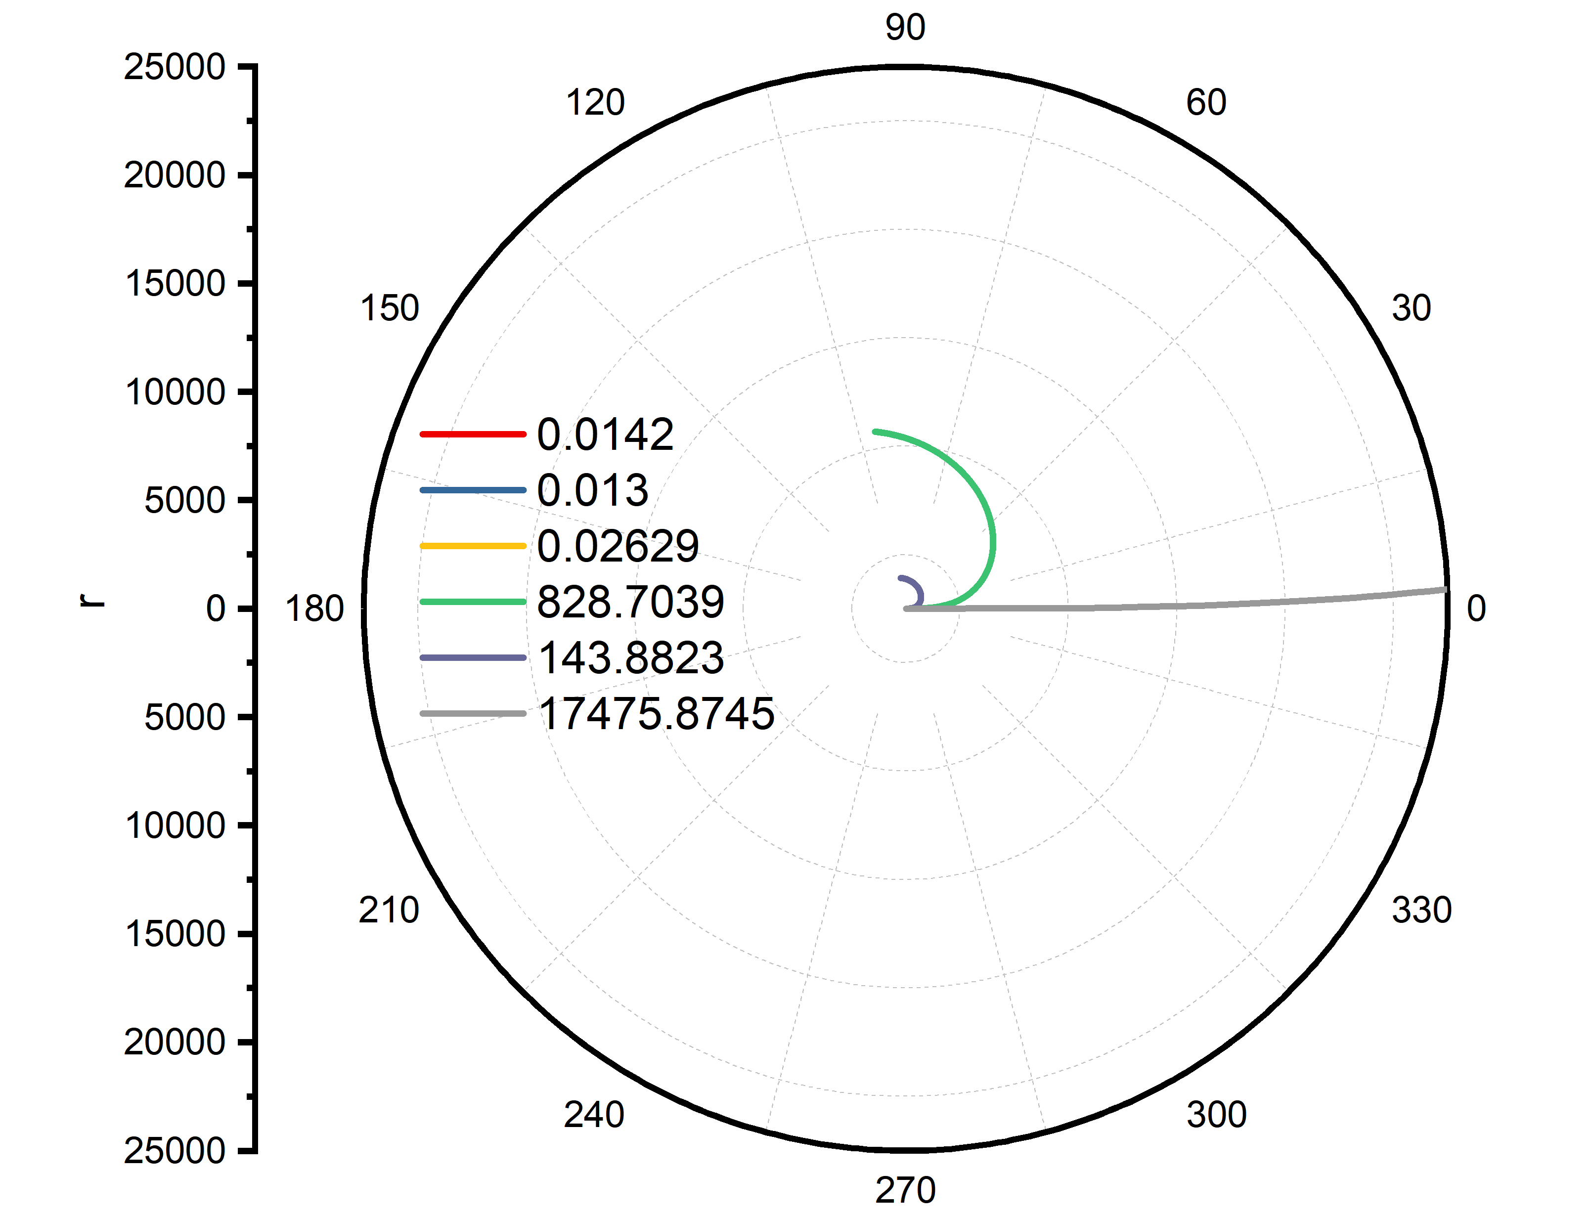
Spiral scaling
After plotting part of the spirals to see how the scale is affecting…
Smaller spirals should have larger a values (the reverse to my previous plotting)
Need replotting
0-1
0-5000
0-100
0-10000

